Slide 1
Low –fidelity prototype

Slide 2
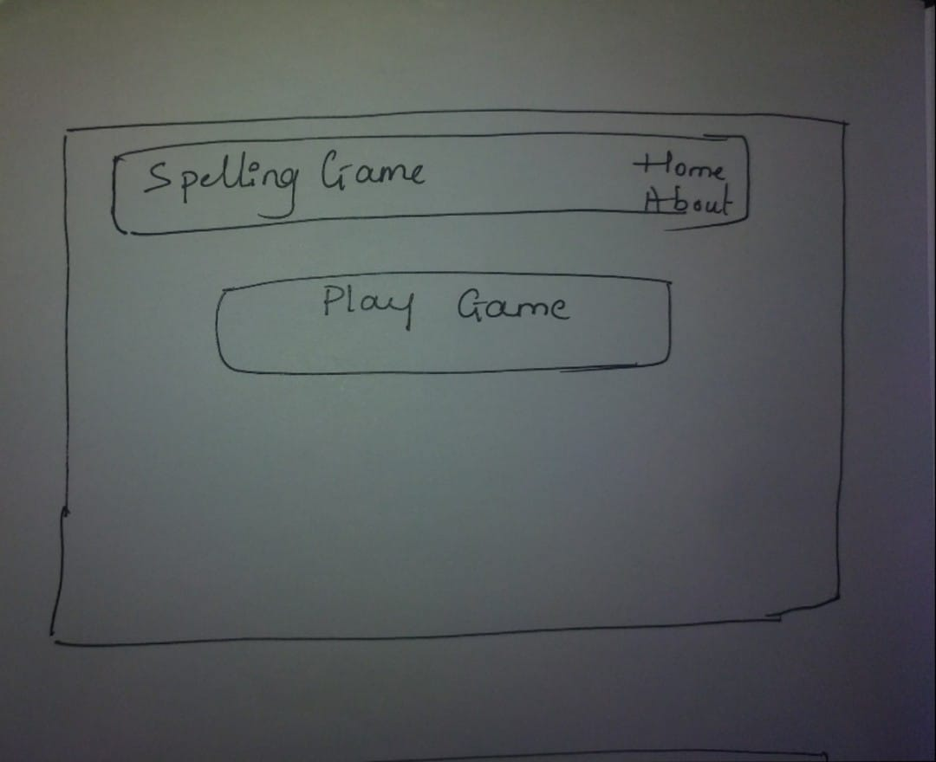
Index Page

Slide 3
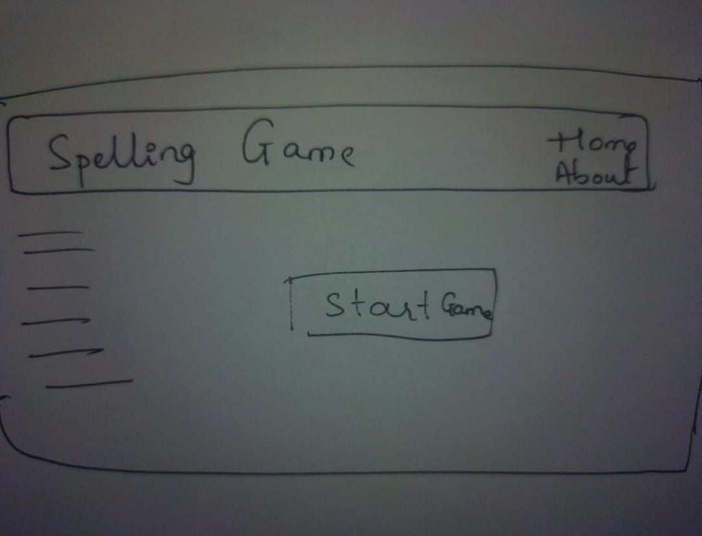
Game Starting

Slide 4
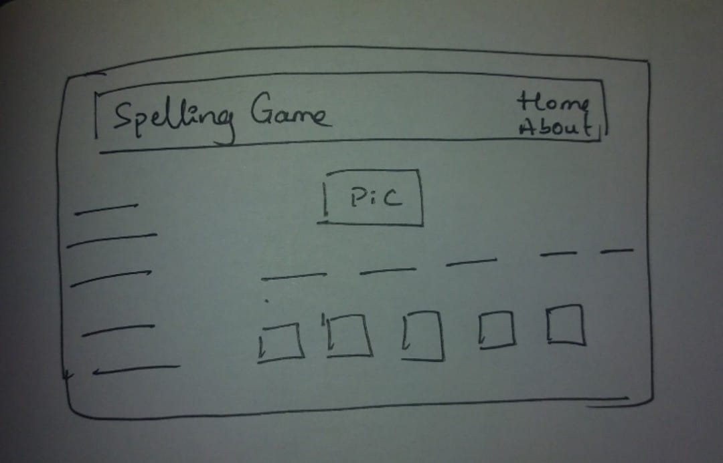
Spelling game

Slide 5
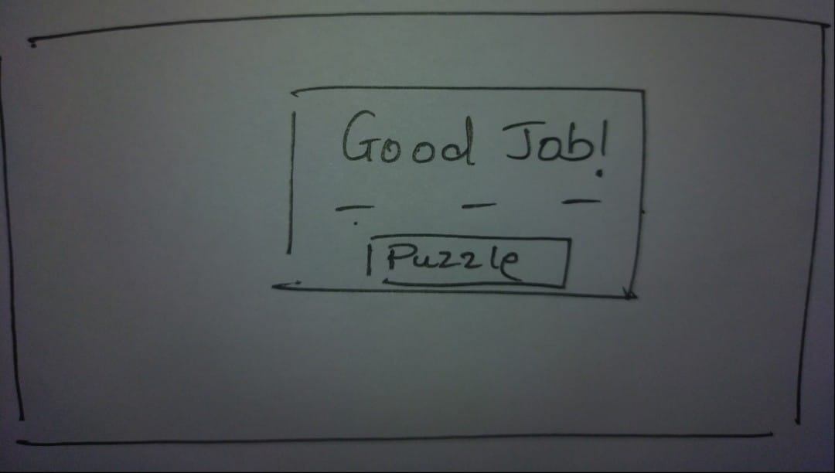
Appreciation after correct selection

Slide 6
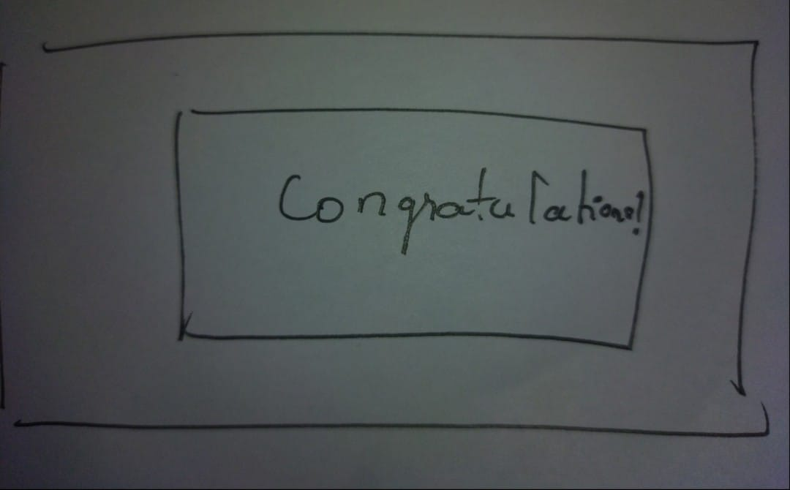
Congratulation after successful attempt

Slide 7
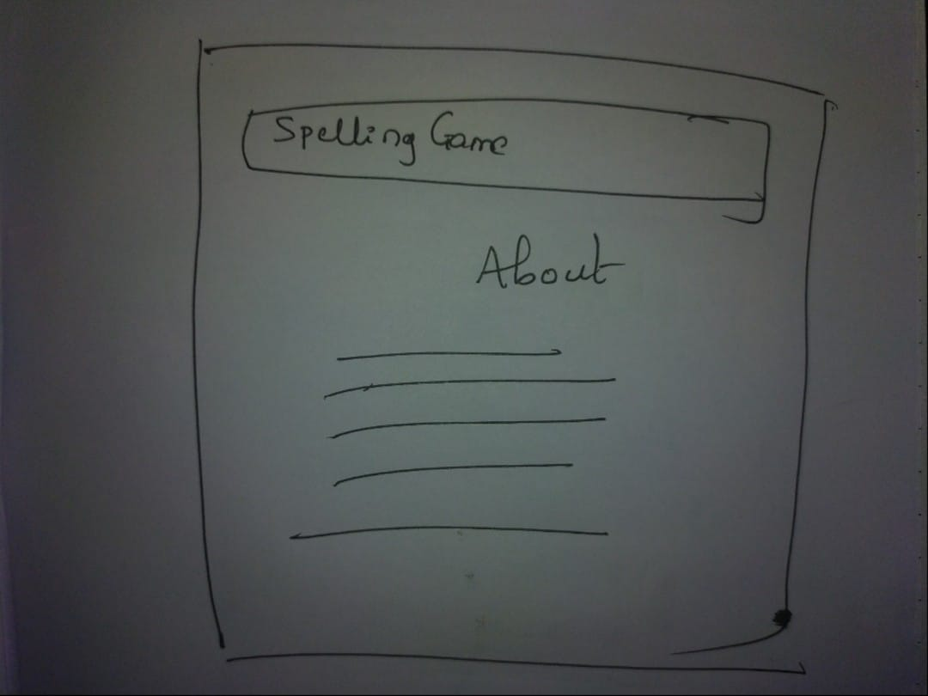
About Game

